Slide 1
Year 1 Phonics Screening Check

Slide 2
Week commencing:
June 9th 2025

Slide 3
A word reading test at the end of Year 1 - with their teacher
40 words
20 real words
20 nonsense (monster) words

Slide 4
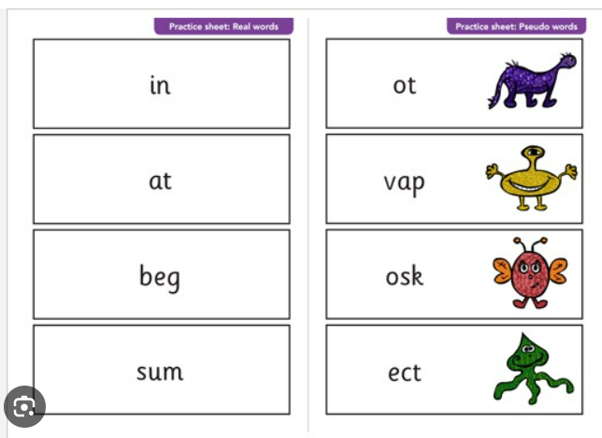

Slide 5
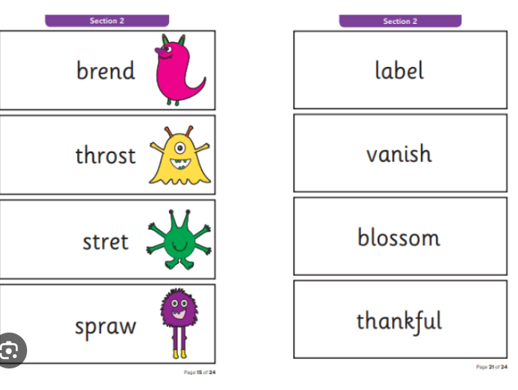

Slide 6
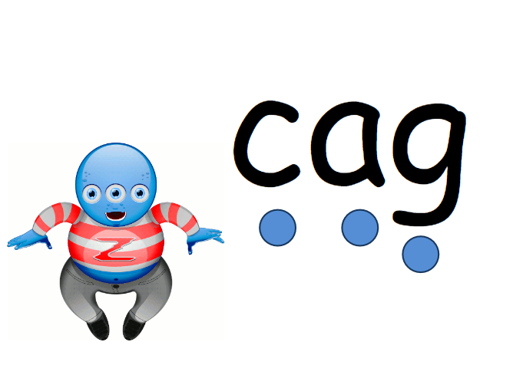

Slide 7
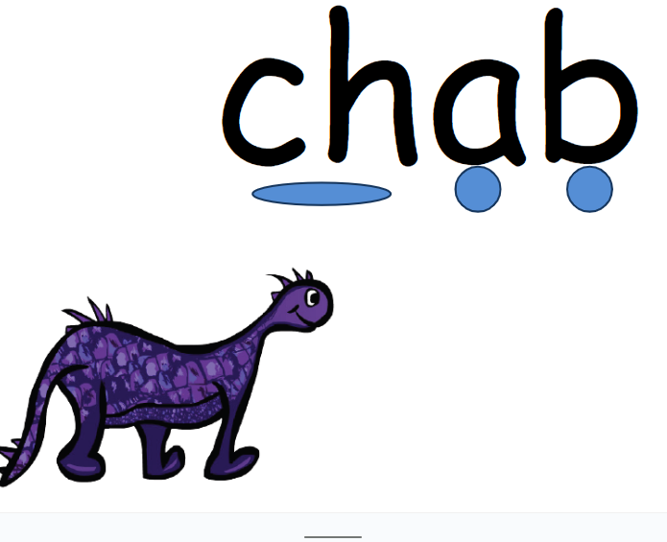

Slide 8
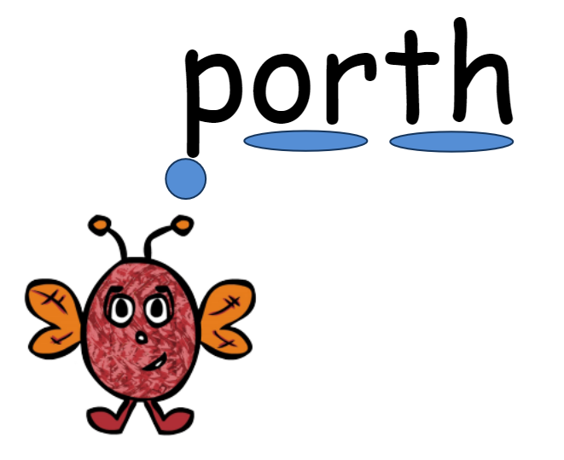

Slide 9


Slide 10


Slide 11


Slide 12

a-e
e-e
i-e
o-e
u-e

Slide 13


Slide 14
Practise their sounds - using their individual highlighted sheets
Read daily

Slide 15
Practise the weekly phonics sheets that we will be sending home – put sound buttons on and then read the words

