Slide 1

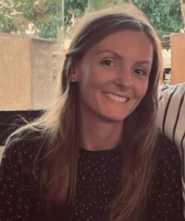
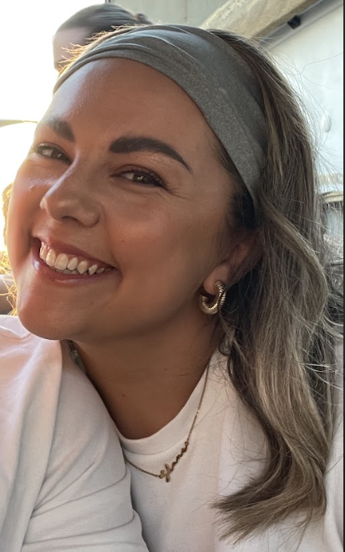
Welcome to Year 2!
Miss Fairhurst
Miss Brownlee

Slide 2
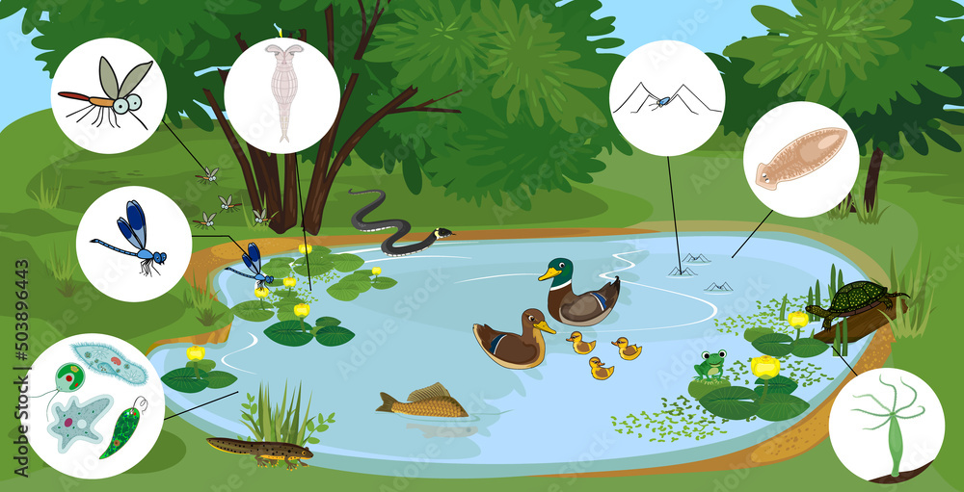
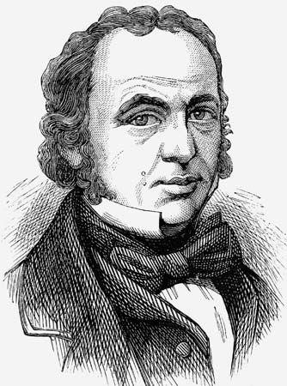
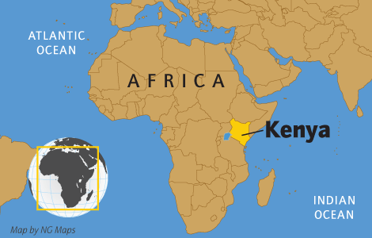
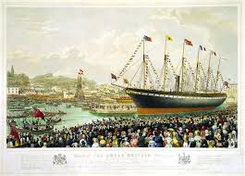

Our learning enquiries
Autumn
(Term 1 and 2)
Spring
(Term 3 and 4)
Summer
(Term 5 and 6)
What makes a habitat successful?
What difference did Brunel make to Bristol?
What will we see when we explore the world?

Slide 3
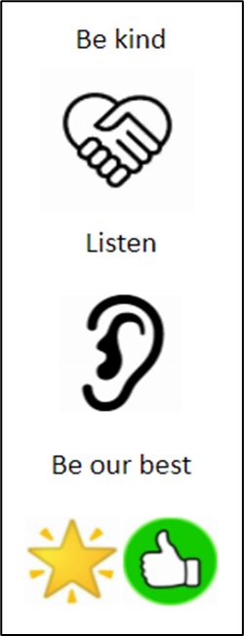
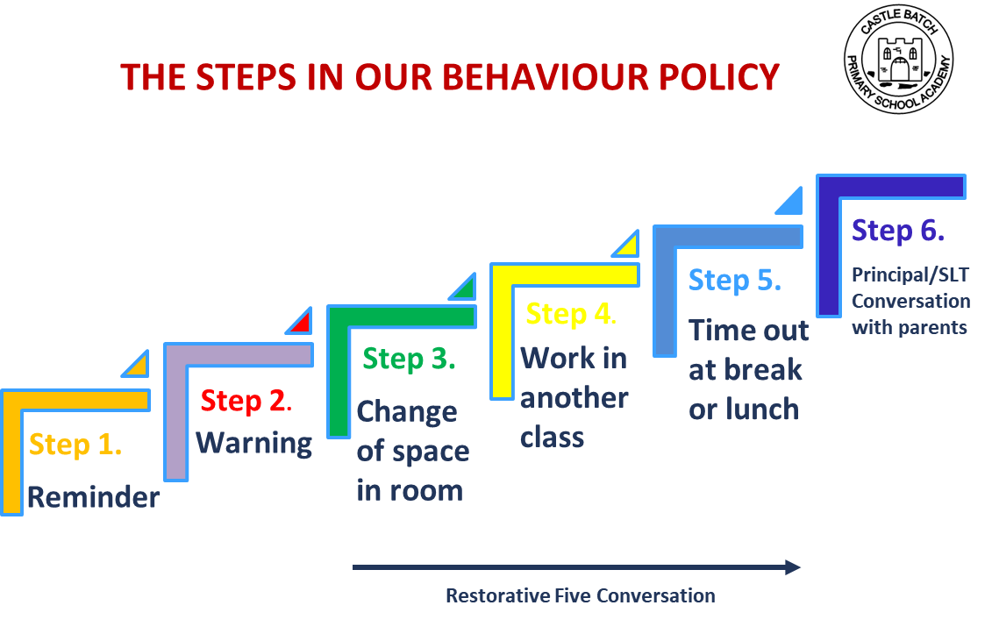
Year 1 → Year 2
What stays the same?
Timetable
Fruit at morning playtime
School dinners
Afternoon playtime
Behaviour policy, school rules and rewards
(Postcards of Praise, Hot Chocolate Friday, Learning Champions,
Top Table)

Slide 4
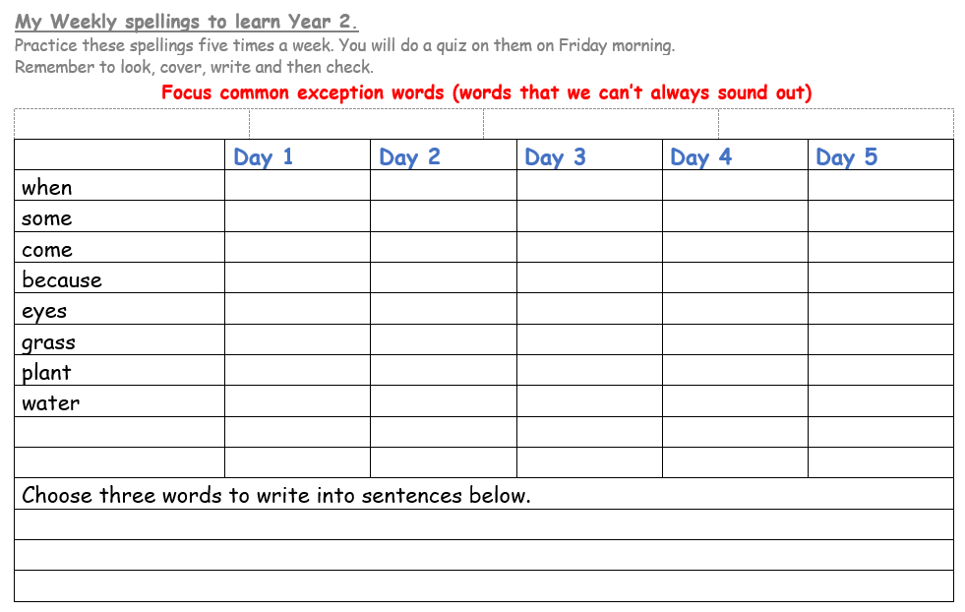
Year 1 → Year 2
What changes?
Weekly spelling list sent home to learn for a weekly test each Friday
Promote more independence ready for KS2

Slide 5

How can you help at home?
Listen to your child read at least three times a week. Please sign in their reading record to say this has happened. This book will be changed once a week.
Spelling lists are shared each week and should be practised at home ready for a weekly quiz.
Maths can be practiced using the website Numbots. If you do not have your child’s login, please let us know.
Teaching your child to tell the time as well as the 2, 5 and 10 times table are also useful skills for Year 2.
Please do not hesitate to contact us if you need any further support with home learning.

Slide 6
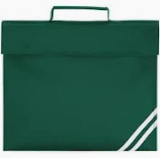

What will my child need?
• Reading book and reading diary every day
• Water bottle which is clearly labelled
• Book bag – no backpacks
Drawstring bag with a spare change of clothes
Please can we remind you that your child should not bring any other objects, fidgets or toys into school unless agreed with their class teacher.

Slide 7
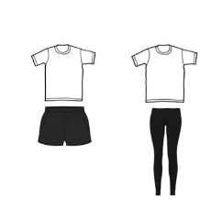
P.E. expectations
Children come into school wearing their P.E. kit
Trainers, black / navy shorts or joggers, plain white t-shirt and a black jacket if needed
Earrings need to be taken out or tapped over before school

Slide 8
Communication
School Facebook Page.
WeDuc - if you have not got the app please go to the office where they will be able to set you up on this. This is our main line of communication where important dates, notices, newsletter etc are sent to.
Notice boards outside of classrooms.

Slide 9

Thank you for listening.
Open door policy- please talk to us!
Any questions?

