Slide 1
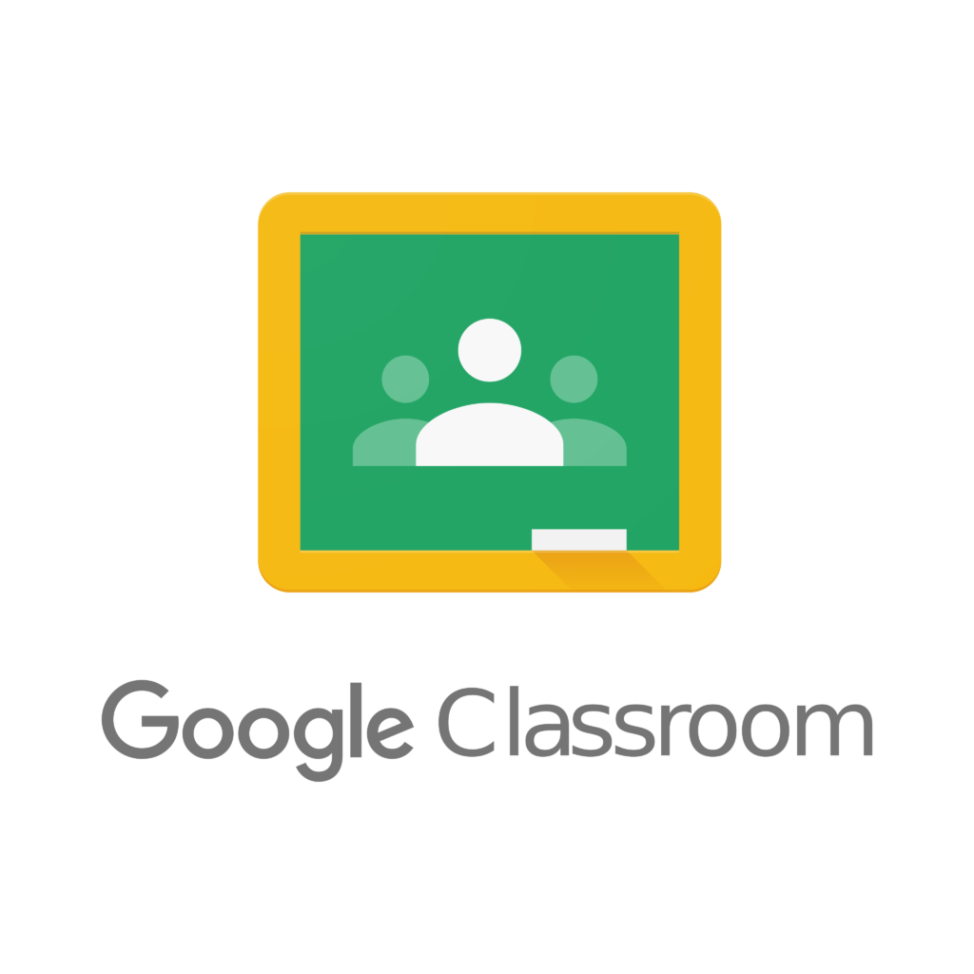
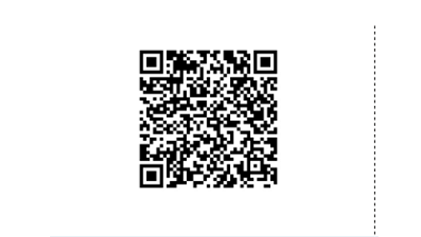
How to access Google Classroom remotely.
Your child would have been given a ‘magic badge’ which is their unique QR log in code. You will need this to access your child’s Google Classroom.

Slide 2
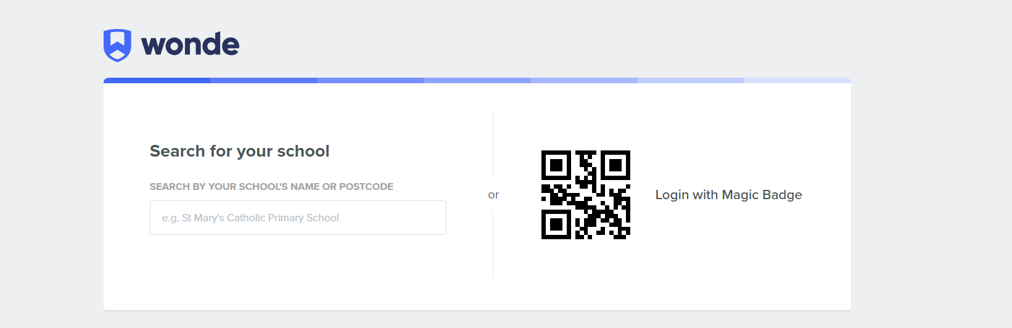
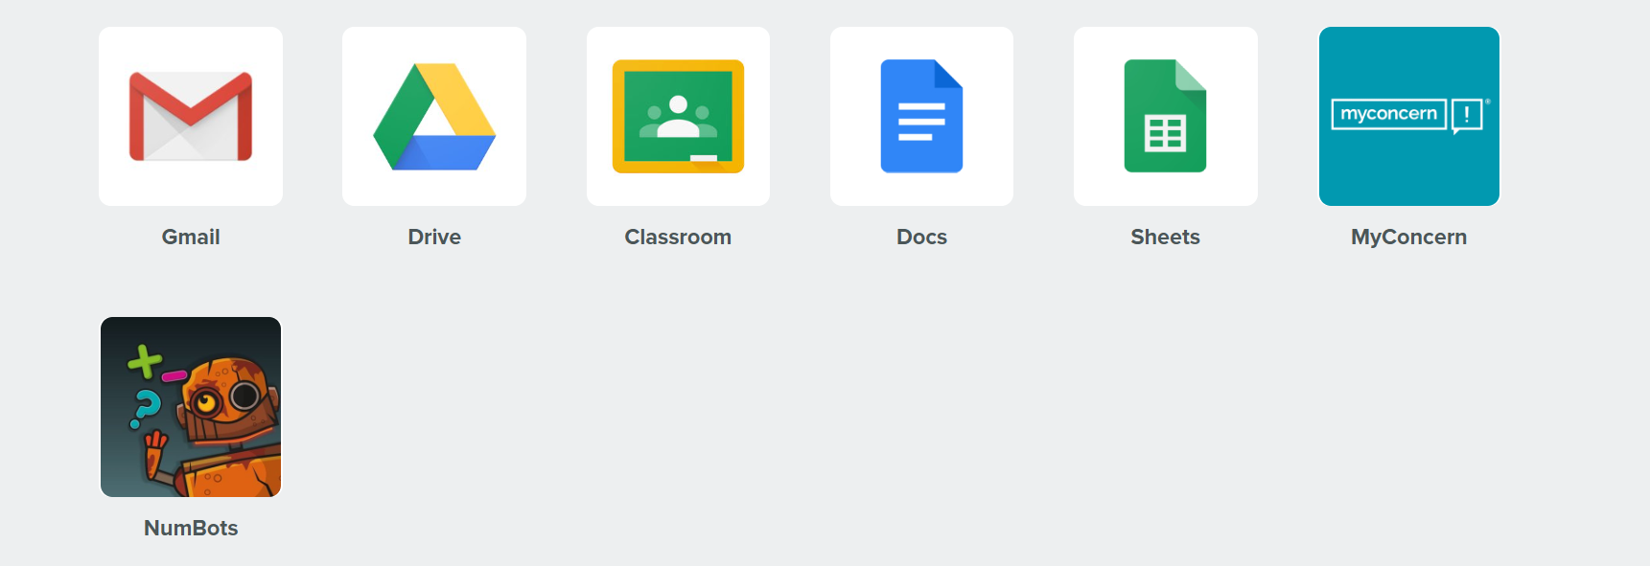
In your internet browser, type in https://edu.wonde.com/login
Click on ‘Log in with Magic Badge’
Once logged in, click on Google Classroom and this will take you to your child’s remote classroom.

Slide 3
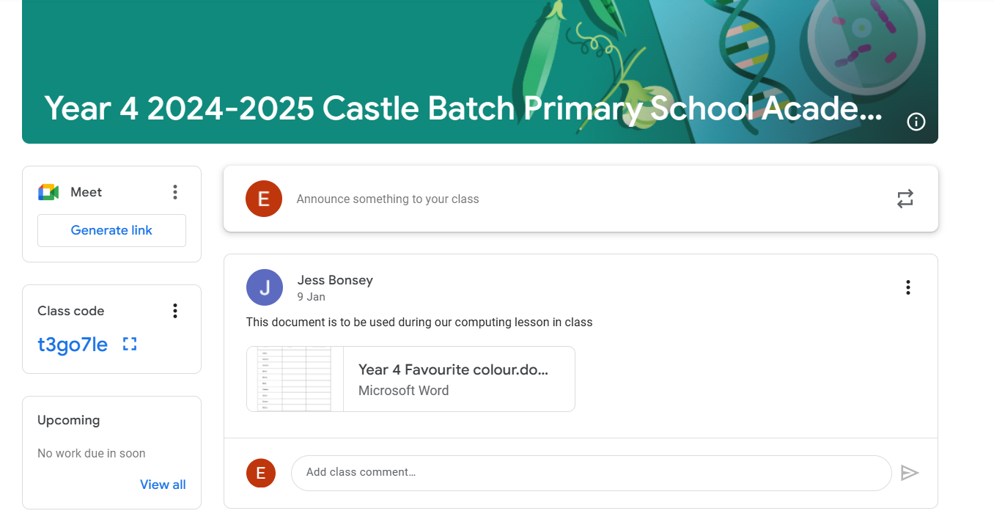
You will now enter your child’s remote classroom. Any work that has been set/uploaded will appear in the class stream.

